Slide 1
H2S-NN: Meta-Path-Structured Sheaf Neural Networks for Heterogeneous Heterophilic Graphs
Progress report: model v3-B, reviewer-driven storyline, plan to IJCAI-27
Presented by Peeradon Sarnkaew
2026/11/11
Notes:
Hello everyone. Today I will present G-Designer, a paper by Zhang and colleagues from ICML 2025. The title is "Architecting Multi-agent Communication Topologies via Graph Neural Networks". In one sentence: the paper uses a graph neural network to decide the topology of multi-AI agents coordinating system, by assumption that the topology should be based on.

Slide 2
Outline
Background
Problem
Method
Experiments
Discussion
1.
Background
Heterophily on heterogeneous graphs; meta-path schema vs. meta-path instance
2.
Problem
Research question; what splitting by meta-path removes; how prior work compares
3.
Method
Meta-path instances as faces of one sheaf; one energy; what changed and what is still open
4.
Experiments
What the reviewers asked for and the experiments that answer it; datasets, protocol
5.
Discussion
Paper status (IJCAI-27), plan to the deadline, decisions for today
Notes:
[0:20–0:50] คำถามวิจัยของวันนี้มีประโยคเดียว (กล่องขวา): ถ้าเรามีคำถามหนึ่งข้อ และมีทีม AI หลายตัวที่แต่ละตัวมีบทบาทต่างกัน เราควรให้ “ใครส่งข้อความให้ใคร” จึงจะได้คำตอบที่ดีที่สุด โดยไม่เปลืองค่าใช้จ่ายเกินจำเป็น
ลำดับการเล่ามี 5 ส่วน ตรงกับแถบด้านบนของทุกสไลด์
1) Background — นิยามว่า agent คืออะไร ทำไมทีม agent จึงมองเป็นกราฟได้ และทีมตอบคำถามบนกราฟอย่างไร
2) Problem — หลักฐานว่ากราฟแบบเดียวไม่เหมาะกับทุกคำถาม และเป้าหมาย MACP ที่ผู้เขียนตั้งไว้
3) Method — ทบทวน GCN กับ VGAE สั้น ๆ แล้วเข้า 4 ขั้นของ G-Designer พร้อมสมการทุกตัว
4) Experiments — ชุดข้อมูล ตัวชี้วัด และผลลัพธ์
5) Discussion — ข้อจำกัดที่ควรระวัง และสิ่งที่ควรจำ
ระหว่างทางถ้ามีศัพท์ไหนไม่ชัด ถามได้ทันที

Slide 3
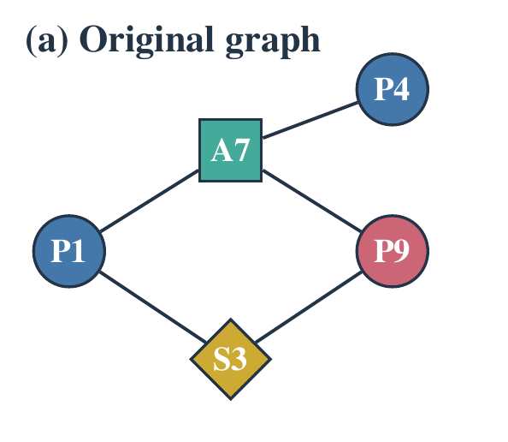
Heterogeneous graphs are often heterophilic
Background
Problem
Method
Experiments
Discussion
Heterogeneous
Several node types (paper, author, subject) and relation types (writes, has subject).
Heterophily
Linked nodes often have different labels: P1 and P9 share an author but belong to different fields, so adjacency does not imply agreement.
Meta-path schema and meta-path instance
A schema is a type pattern, e.g. paper–author–paper. A meta-path instance is one concrete walk that follows it, e.g. P1–A7–P9.
The benchmarks span the range
Adjusted heterophily ℋ² (H2GB [9]): IMDB 0.74 (per genre), Freebase 0.995; plus H2GB sets (IEEE-CIS-G, mag-year, ogbn-mag, H-Pokec).
ℋ² = mean adjusted heterophily over length-2 meta-paths [9], built on adjusted homophily [13]; MLH [10]. Values from our reference-code run.

Slide 4
Research question
Background
Problem
Method
Experiments
Discussion
Heterogeneous graphs are frequently heterophilic: entities of one type are linked to entities of other types whose classes differ, so adjacency does not imply label agreement. Existing methods address this indirectly. They decompose the graph into one homogeneous view per meta-path schema and then fuse the views. Heterophily is therefore assessed on derived graphs rather than on the original one, and all node pairs connected under the same schema are treated identically, which discards both the intermediate entities and the particular meta-path instances that join them. We ask whether heterophily can instead be handled directly on the original graph, by making meta-path instances part of the structure on which the model operates, and whether doing so yields information that schema-level encoders and instance-level features cannot provide.
Two limitations of meta-path views
• Heterophily is judged on derived graphs, not on the original graph.
• Every pair under the same schema is treated alike; the instance is ignored.
Two goals
• (i) One model on the original graph handles heterophily, with no branch per schema.
• (ii) Meta-path instances, used as structure, carry information that schema-level encoders and instance-level features do not.

Slide 5
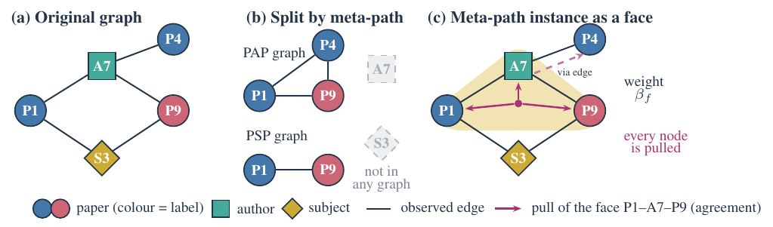
Splitting by meta-path removes the intermediate nodes
Background
Problem
Method
Experiments
Discussion
• Split (b): the PAP graph links P1–P9, P1–P4 and P4–P9; the PSP graph links P1–P9. A7 and S3 are in neither graph.
• Ours (c): the instance P1–A7–P9 is a face on the original graph. P1, A7 and P9 are all pulled toward agreement with it, and A7 passes the effect on to P4 through its own edge.

Slide 6
Prior work, compared at the level of the update
Background
Problem
Method
Experiments
Discussion
Method | Stalk of the instance | Maps | Intermediate nodes updated
MAGNN [1] | feature of the target | relation-only rotations | no (target only)
SGAT [8] | feature of the target | none | no (target only)
HetSheaf [3] / NSD [2] | none (edges only) | learned per edge | n/a
Sheaf Hypergraph Networks [4] | none (eliminated) | free MLP per node and hyperedge | yes
CWN [5] | yes | free MLPs; faces = induced cycles | yes
CCNN [6] / CTNN [7] | yes | free per incidence | yes
H2S-NN | yes, a variable of the solve | forced by the edge maps | yes
Not new: using intermediate nodes of an instance (MAGNN, SGAT); faces with a stalk (CWN, CCNN); sheaves on hypergraphs.
Our statement: instances are faces of the same sheaf as the graph, their maps are forced by the edge maps, and the identity of the intermediate node enters the geometry.
Formula-level comparison: v3B_prior_art. arXiv 2606.00937 and DSHN were checked at abstract level only and are not claimed against.

Slide 7
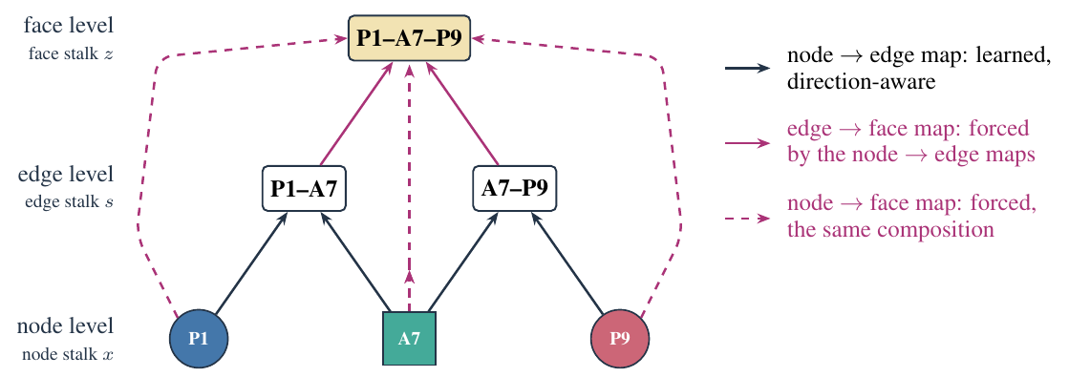
A meta-path instance as a face of the sheaf
Background
Problem
Method
Experiments
Discussion
Three levels
node, edge, face (the 0-, 1- and 2-dimensional cells). Each carries a stalk; restriction maps connect the levels.
Face
a face, i.e. a two-dimensional face (2-cell): one sampled meta-path instance attached to the nodes and edges it traverses. No closing edge: the path need not return to its start.
Forced maps
Edge→face and node→face maps are the composition of the learned node→edge maps along the path, so a face has no parameters except its weight.
• Learned: node→edge maps (direction-aware, orthogonal), edge weights, one weight per face.
• Sampled: faces, by WISP random walks on the original graph; no meta-path list.
• Kept from the graph: its own consistent assignments stay consistent after adding faces.

Slide 8
One energy over nodes, edges and faces
Background
Problem
Method
Experiments
Discussion
E = ½ Σ_edges a_e Σ_{v∈e} ‖F x_v − s_e‖² + ½ Σ_faces β_f [ Σ_{e∈f} ‖R s_e − z_f‖² + Σ_{v∈f} ‖T x_v − z_f‖² ]
F: node→edge map (learned). R, T: edge→face and node→face maps (forced by F). a_e, β_f: edge and face weights (β_f from the whole instance).
What it computes
• Each term measures disagreement after transport: between a node and its edge, an edge and its face, a node and its face.
• A node is influenced by its edges and by every face through it, including intermediate nodes of a face.
• Node representations are the minimiser of this energy anchored at the encoding, found once per forward pass.
What it guarantees
• A unique solution for every value of the learned parameters.
• A consistent encoding is a fixed point: adding faces does not break the graph's own structure.
• Nodes in a face receive its influence directly, not through an endpoint-to-endpoint shortcut.
Honest note: the node-level solve is a personalised-PageRank resolvent; the contribution is the operator, not the solver.

Slide 9
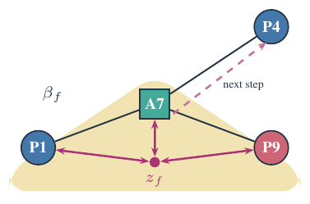
One face, step by step: P1–A7–P9
Background
Problem
Method
Experiments
Discussion
1 Transport
The node→edge maps of P1–A7 and A7–P9 are composed along the path, so all three nodes are expressed in the face's frame.
2 Face stalk
The face carries a stalk z_f that its nodes and edges must agree with.
3 Pull every node
P1, A7 and P9 are all pulled toward z_f in proportion to the face weight β_f; A7 is updated directly.
4 Edges carry it on
A7 is also in the edge A7–P4, so the effect reaches P4 through the edge terms.
Stated in the paper: if the maps depended only on the relation type and no edge stalks were kept, the face would reduce to MAGNN's encoder with relation-only rotations (checked numerically, 1.2·10⁻¹⁶). Here the maps are pair- and role-conditioned, so the identity of A7 enters the geometry.

Slide 10
Where heterophily is handled
Background
Problem
Method
Experiments
Discussion
Where | Mechanism | What we can state
Restriction maps | direction-aware orthogonal maps; neighbours of different classes agree after transport, not before | for any labelling, maps exist that make class-separating assignments consistent (Thm 4)
Face weight β_f | weight from all nodes and relations of the instance | no ceiling on one face's pull; no schema branch (needs the node–face term)
Readout | head reads the node's own encoding next to its propagated stalk | both low-pass and high-pass responses are available per coordinate (no band-pass: limit)
What this does not show: that the gains on real data come from this. That is claim C6 (gain stratified by ℋ²), a result we do not have yet.

Slide 11
What the WSDM reviewers asked for, and the answer
Background
Problem
Method
Experiments
Discussion
Reviewer request | Source | Answer in this version
Heterophily must be shown and analysed by degree | meta-review, R2 W4, R3 W1, R4 | ℋ² and MLH on every dataset; H2GB sets added; gain stratified by ℋ² [result]
Face reaches nodes only through the closure edge | meta-review, R2 W3 | face is coupled directly to every node (Thm 8); closure edge carries no stalk (Thm 1b)
Isolate the face from weighting, capacity, selection | meta-review, R2 c5, R4 | arms on identical sampled faces and parameter budget; full vs closure_only [result]
Cost vs graph size and number of instances | meta-review, R1, R2, R3, R4 | cost gate and scaling curves; ≈ 1.7× v2 time is an estimate, not measured
Same-protocol baselines; HetSheaf rerun | meta-review, R1, R2, R4 | every baseline rerun under one protocol; 10 seeds; Wilcoxon + Holm
Tie each contribution to the problem | R2 c2 | two limitations and two goals drive the contributions
Figures consistent with the text | R2 c3, c4 | one symbol set for figures and Method

Slide 12
What changed since WSDM, and what is still open
Background
Problem
Method
Experiments
Discussion
Changed
• The instance is a face with its own stalk, coupled to every node. Closure edge: definitional only.
• One anchored energy minimisation replaces Euler steps on a Hodge Laplacian (which cannot carry face information to nodes: Lemma A′).
• WISP samples instances without a meta-path list.
• Removed: gates, Chebyshev filter bank, SheafCovPool, edge cochain operator.
• Every result is rerun.
Open (stated in the paper)
• Influence is symmetric in strength; direction lives in the maps (limit L1′).
• Edge stalks on shared edges: no example yet where they are decisive. We do not claim they add information (C11).
• Cost is derived, not measured: estimate ≈ v2 memory, ≈ 1.7× time; gate: ≤ 3× memory, ≤ 4× time.
• Propagation is linear; no band-pass response.
• Claims C10–C14 are untested: all results are [result].

Slide 13
Experiments that decide each claim
Background
Problem
Method
Experiments
Discussion
Comparison (same sampled faces, matched parameters) | Claim | Claim fails if
full vs no_faces | C2: faces help at all | not better
weight ladder uniform ⊂ schema ⊂ endpoints ⊂ full | C2: instance content matters | full ≯ endpoints on ≥ 2 of 3 HGB sets
full vs closure_only (one endpoint edge per instance) | C10: face ≠ its closure | not better on ≥ 2 of 3
full vs instance_features (MAGNN-like, no face in the solve) | C14: structure vs feature | not better
full vs covering_only (no node–face term) | C12: node–face term needed | covering_only not worse
full vs hub_A (no edge stalks) | C11: edge stalks add | not better (then: not claimed)
gain of full over endpoints vs ℋ² | C6: heterophily | no monotone relation
10 seeds, paired Wilcoxon with Holm correction; consequences of each outcome were fixed before any run. Cost gate on ACM, DBLP, IMDB before the protocol.

Slide 14
Datasets and protocol
Background
Problem
Method
Experiments
Discussion
Task | Datasets | Metrics
Node classification (main) | HGB [11] ACM, DBLP, IMDB, Freebase; H2GB [9] IEEE-CIS-G, mag-year, ogbn-mag, H-Pokec (mini-batch) | macro/micro-F1 (H2GB: its metrics); ℋ² and MLH per dataset
Link prediction (secondary) | ACM P–A, DBLP A–P, IMDB M–A, Freebase book–book, PubMed, LastFM; ogbn-mag citation, H-Pokec friendship | MRR, Hits@10 with HeaRT [12] hard negatives; warm vs cold-start
Graph classification (appendix) | MUTAG, PROTEINS, ENZYMES, NCI1 (atom and bond labels as types) | generalizability only; no heterophily claim
• All baselines rerun under one protocol; HetSheaf is mandatory; no number from the old tables is reused.
• Identical tuning budget for every method and arm; selection on validation only.
• WISP settings pre-registered and never tuned.

Slide 15
Paper status and plan to the deadline
Background
Problem
Method
Experiments
Discussion
When | What | Output
Nov 11 – 20 | paper rewrite on v3-B up to Experiments; cost gate (C13); instance_features arm; link-prediction card | draft + gate numbers
Nov 21 – 30 | audit the experiment table; freeze spec and code with a commit hash | frozen spec + hash
Dec 1 – 15 | TSUBAME: pipeline gate; C2, C10, C12, C14 on HGB | full or narrowed claim
Dec 16 – 28 | full node-classification and link-prediction tables; ℋ² stratification | all [result] filled
Dec 29 – Jan 3 | results and discussion; internal review | complete draft
Jan 4 / Jan 11, 2027 | abstract / full paper deadlines (IJCAI-27)
IJCAI-27: 7 pages including figures + 2 pages of references, anonymous; appendix for proofs, WISP and graph classification.
Risks: TSUBAME access; a kill rule firing (the narrowed paper is written in advance); cost gate missed (fixed-step truncation instead of the exact solve).

Slide 16
Decisions for today
Background
Problem
Method
Experiments
Discussion
1 Framing
Meta-path instances as faces of the graph's own sheaf; terms: node, edge, face (a face is a 2-cell); no "Hodge". Title as above.
2 Narrowed claims, agreed now
If full ≯ endpoints: no claim that instance content adds information. If full ≯ instance_features: faces act as instance encoders and the contribution is the geometry. If C11 fails: edge stalks are not claimed.
3 Cost
Run the cost gate first; if it fails, use fixed-step truncation and report it.
4 Compute
TSUBAME: A100 40 or 80 GB? Job time limit and quota.

Slide 17
References
[1] X. Fu, J. Zhang, Z. Meng, I. King. MAGNN: Metapath aggregated graph neural network for heterogeneous graph embedding. WWW 2020.
[2] C. Bodnar, F. Di Giovanni, B. Chamberlain, P. Liò, M. Bronstein. Neural sheaf diffusion: a topological perspective on heterophily and oversmoothing in GNNs. NeurIPS 2022.
[3] L. Braithwaite et al. Heterogeneous sheaf neural networks. arXiv:2409.08036, 2024.
[4] I. Duta, G. Cassarà, F. Silvestri, P. Liò. Sheaf hypergraph networks. NeurIPS 2023.
[5] C. Bodnar, F. Frasca, N. Otter, Y. G. Wang, P. Liò, G. Montúfar, M. Bronstein. Weisfeiler and Lehman go cellular: CW networks. NeurIPS 2021.
[6] M. Hajij et al. Topological deep learning: going beyond graph data. arXiv:2206.00606, 2022.
[7] M. Hajij et al. Copresheaf topological neural networks: a generalized deep learning framework. NeurIPS 2025 (arXiv:2505.21251).
[8] S. H. Lee, F. Ji, W. P. Tay. SGAT: Simplicial graph attention network. IJCAI 2022 (arXiv:2207.11761).
[9] J. Lin, X. Guo, S. Zhang, Y. Zhu, J. Shun. When heterophily meets heterogeneity: challenges and a new large-scale graph benchmark. KDD 2025.
[10] J. Li et al. Heterophily-aware representation learning on heterogeneous graphs. IEEE TPAMI 47(9), 2025.
[11] Q. Lv et al. Are we really making much progress? Revisiting, benchmarking and refining heterogeneous graph neural networks. KDD 2021.
[12] J. Li et al. Evaluating graph neural networks for link prediction: current pitfalls and new benchmarking. NeurIPS Datasets and Benchmarks 2023.
[13] O. Platonov, D. Kuznedelev, A. Babenko, L. Prokhorenkova. Characterizing graph datasets for node classification: homophily-heterophily dichotomy and beyond. NeurIPS 2023.

Slide 18
Appendix · Terms used in this talk
Term | Meaning
Meta-path schema | a type pattern, e.g. paper–author–paper
Meta-path instance | one concrete walk that follows a schema, e.g. P1–A7–P9
Cell; face | a cell is a node (0-cell), edge (1-cell) or face (2-cell); a face is one sampled meta-path instance
Stalk | the vector space attached to a node, an edge or a face; x_v, s_e, z_f denote the vector it holds
Restriction map | maps a stalk to the next level: node→edge (learned), edge→face and node→face (forced)
Transport | restriction maps composed along an instance, bringing its nodes into one frame
Energy | sum of disagreements between stalks at all levels; minimised once per forward pass
WISP | Walk-sampled, Instance-weighted Sheaf Paths: the schema-free sampler
ℋ² | adjusted heterophily over length-2 meta-paths (H2GB)

